Slide 1
The Natural Resource Curse: A Survey
By Jeffery A. Frankel

Slide 2
Observation
It has been observed for some decades that the possession of oil, natural gas, or other valuable mineral deposits or natural resources does not necessarily confer economic success.
Many African countries such as Angola, Nigeria, Sudan, and the Congo are rich in oil, diamonds, or other minerals, and yet people continue to experience low per capita income and low quality of life.
Meanwhile, the East Asian economies Japan, Korea, Taiwan, Singapore and Hong Kong have achieved western-level standards of living despite being rocky islands with virtually no exportable natural resources.

Slide 3
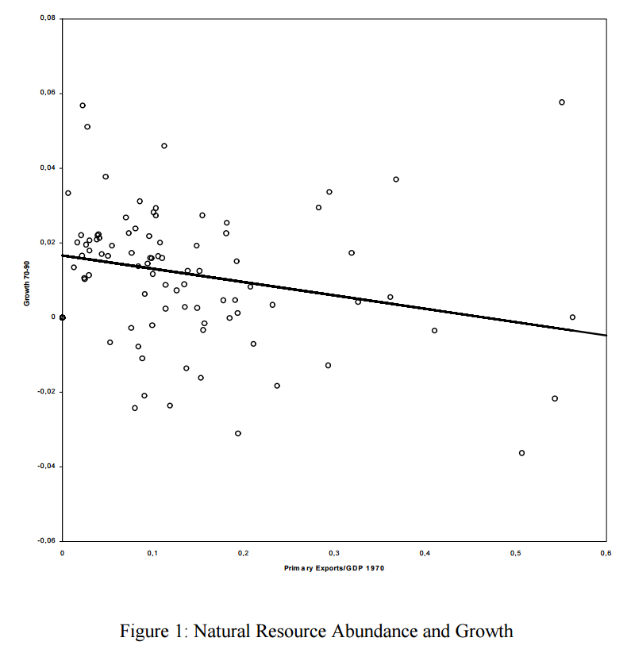
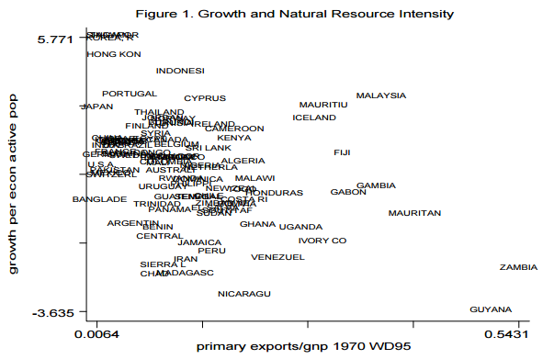
Manzano and Rigobon (2008)
Sachs and Warner (1995)

Slide 4
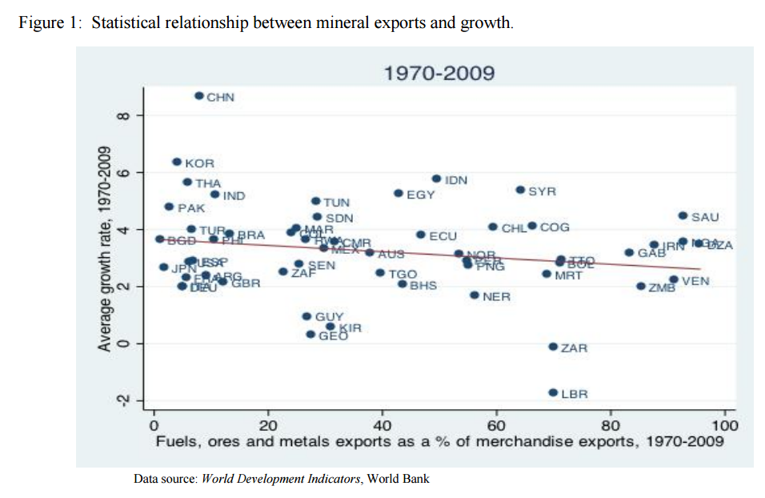

Slide 5
Some Previous Researches
Auty (1993, 2001) is the one who coined the phrase “natural resource curse” to describe this puzzling phenomenon.
Sachs and Warner (1995) kicked off the econometric literature, finding that economic dependence on oil and mineral is correlated
with slow economic growth, controlling for other structural attributes of the country. They (2001) summarized and extended previous research showing evidence that countries with great natural resource wealth tend to grow more slowly than resource poor countries.
Other studies that find a negative effect of oil, in particular, on economic performance, include Kaldor, Karl and Said (2007); Sala-i-Martin and Subramanian (2003); and Smith (2004)

Slide 6
Some Previous Researches
The result is by no means universal: Norway;
Botswana and the Congo: both abundant in diamonds. Botswana is the best performer in continental Africa in terms of democracy, stability, and rapid growth of income, while the Congo is among the very worst.
Delacroix (1977), Davis (1995), Herb (2005) and Maloney (2002) all find no evidence of the natural resource curse.
Alexeev and Conrad (2009) find that oil wealth and mineral wealth have positive effects on income per capita, when controlling for a number of variables, particularly dummies for East Asia and Latin America. In some cases, especially if the data do not go back to a time before oil was discovered, the reason different studies come to different results is that oil wealth may raise the level of per capita income, while reducing or failing to raise the growth rate of income

Slide 7
Some Previous Researches
In some cases the crucial difference is whether “natural resource wealth” is measured by true endowments, or rather by exports.
Some argue that natural resource exports are highly endogenous in several ways.
On the one hand, basic trade theory readily predicts that a country may show a high mineral share in exports, not necessarily because it has a higher endowment of minerals than other countries (absolute advantage) but because it does not have the ability to export manufactures (comparative advantage.).
On the other hand, the skeptics also have plenty of examples where successful institutions and industrialization went hand in hand with rapid development of mineral resources.
Eg: The United States during its pre-war industrialization period, Venezuela from the 1920s to the 1970s, Australia since
the 1960s, Norway since its oil discoveries of 1969, Chile since adoption of a new mining code in 1983, Peru since a privatization program in 1992, and Brazil since the lifting of restrictions on foreign mining participation in 1995

Slide 8
Six Major Hypotheses
BIG CONCEPT
1. Long-run trend of world prices for commodities.
2. Volatility in commodity prices.
3. Permanent crowding out of manufacturing, where spillover effects are thought to be
concentrated.
4. Autocratic or oligarchic institutions.
5. Anarchic institutions: unenforceable property rights, unsustainably rapid depletion, or
civil war.
6. Cyclical expansion of the non-traded sector via the Dutch Disease.

Slide 9
I. Long-term trends in world commodity prices
The determination of the export price on world markets
Developing are more likely to fit the small open economy model: price-takers, for both import goods and export goods
low monopoly power
low trade barriers
intrinsic perfect substitutability in the commodity as between domestic and foreign producers – a condition usually met by primary products

Slide 10
I. Long-term trends in world commodity prices
The hypothesis of a declining trend in commodity prices ( Prebisch-Singer hypothesis )
The prices of primary products follow a downward trajectory in the long run, relative to the prices of manufactures and other products world
Demand for primary products is relatively inelastic with respect to world income

Slide 11
I. Long-term trends in world commodity prices
c. The Hypotheses of rising trends in non-renewable resource prices ( Malthus and Hotelling )
A persuasive theoretical arguments that we should expect prices of
oil and other minerals to experience upward trends in the long run.
Assuming :
non-perishable non-renewable resources
safe property rights, excluding fear of contracts abrogated, possessions being nationalized or taken by warlord
Hotelling rule and the interest rate
Malthusianism and the “peak oil” hypothesis

Slide 12
I. Long-term trends in world commodity prices
d. Empirical evidences
Terms of trade for commodity producers had a slight upward trend
from 1870 to World War I, a downward trend in the inter-war period, upward in the1970s, downward in the 1980s and 1990s, and upward in the first decade of the 21st century
What is the overall statistical trend in the long run?
Some authors find a slight upward trend, some a slight downward trend
The answer seems to depend, more than anything else, on the date of the end of the sample. When a real price undergoes large ten-year cycles around a trend, estimates of the trend are very sensitive to the precise time period studied

Slide 13
II. Medium-term Volatility of Commodity Prices
a. Low short-run elasticities
Demand elasticities are low in the short run largely because the capital stock at any point in time is designed physically to operate with a particular ratio of energy to output
Supply elasticities are also often low in the short run because it takes time to adjust output, especially if production is already at capacity so that expansion requires new drilling and new pipelines
Inventories can cushion the short run impact of fluctuations, but they are limited in size
In the longer run, elasticities are far higher, both on the demand side and the supply side
In the medium term, oil may be subject to a cobweb cycle, due to the lags in
response

Slide 14
II. Medium-term Volatility of Commodity Prices
b. Is volatility per se detrimental to economic performance
Some have suggested that it is precisely the volatility of natural resource prices, rather than the trend, that is bad for economic growth
Some studies and historical examples suggest that high volatility can accompany the rapid growth phase of a country’s development
Cyclical shifts of movable resources back and forth across sectors may incur needless transaction costs
Frictional unemployment of labor, incomplete utilization of the capital stock, and incomplete occupancy of housing are true deadweight costs, even if they are temporary
Government may not be better than individual at discerning whether a boom in the price for the export commodity is temporary or permanent
A diversified country may indeed be better off than one specialized in oil or a few other commodities, other things equal

Slide 15
III. Possible Channels of the Natural Resource Curse
a. Is commodity specialization per se detrimental to growth?
Outside of classical economics, diversification out of primary commodities into manufacturing in most circles is considered self-evidently desirable
Is industrialization the sine qua non of economic development? Is encouragement of manufacturing necessary to achieve high income? Classical economic theory says “no:” countries are best off producing whatever is their comparative advantage, whether that is natural resources or manufacturing
But the structuralists were feeling that countries only get sustainably rich if they industrialize, oil-rich sheikdoms notwithstanding, and industrialization in turn requires an extra push from the government. Matsuyama (1992) provided an influential model formalizing this intuition: the manufacturing sector is characterized by learning by doing, while the primary sector is not. The implication would be that deliberate policy-induced diversification out of primary products into manufacturing could help bring about economic development, and that a permanent commodity boom that crowds out manufacturing could indeed retard it.

Slide 16
III. Possible Channels of the Natural Resource Curse
a. Is commodity specialization per se detrimental to growth?
On the other side, there is no reason why learning by doing should be the exclusive preserve of manufacturing tradables. Nontradables can enjoy learning by doing. Mineral and agricultural sectors can as well. Some countries have experienced tremendous productivity growth in the oil, mineral, and agricultural sectors. American productivity gains have been aided, since the late 19th century, by public investment in such knowledge infrastructure institutions as the U.S. Geological Survey, the Columbia School of Mines, the Agricultural Extension program, and Land-Grant Colleges.
Although well-functioning governments have played a role in supplying these public goods for the natural resource sector, this is different than mandating government ownership of the resources themselves.
In Latin America, for example, public monopoly ownership and prohibition on importing foreign expertise or capital has often stunted development of the mineral sector, whereas privatization has set it free. Moreover, attempts by governments to force linkages between the mineral sector and processing industries have not always worked.

Slide 17
III. Possible Channels of the Natural Resource Curse
b. Do mineral riches lead to wars?
Where a valuable resource such as oil or diamonds is there for the taking, rather than requiring substantial inputs of labor and capital investment, factions are more likely to fight over it
Fearon and Laitin (2003), Collier and Hoeffler (2004), Humphreys
(2005) and Collier (2007, Chapter 2) all find that economic dependence on oil and mineral wealth is correlated with civil war
Eg: Angola and Sudan
On the other hand, Brunnschweiler and Bulte (2009) argue that the conventional measure of resource dependence is endogenous with respect to conflict, and that instrumenting for dependence eliminates its significance in conflict regressions. They find conflict increases dependence on resource extraction, rather than the other way around.

Slide 18
III. Possible Channels of the Natural Resource Curse
c. Institutions
1. Institutions and development
Rodrik, Subramanian, and Trebbi (2002) use as their measure of institutional quality an indicator of the rule of law and protection of property rights (taken
from Kaufmann, Kraay and Zoido-Lobaton, 2002).
Acemoglu, Johnson, and Robinson (2001) use a measure of expropriation risk to investors.
Acemoglu, Johnson, Robinson, and Thaicharoen (2003) measure the quality of a country’s “cluster of institutions” by the extent of constraints on the executive.
The theory is that weak institutions lead to inequality, intermittent dictatorship, and lack of any constraints to prevent elites and politicians from plundering the country.
Institutions can be endogenous: the result of economic growth rather than the
cause. Many institutions -- such as the structure of financial markets, mechanisms of income redistribution and social safety nets, tax systems, and intellectual property rules -- tend to evolve endogenously in response to the level of income.

Slide 19
III. Possible Channels of the Natural Resource Curse
c. Institutions
Econometricians address the problem of endogeneity by means of the technique
of instrumental variables.
What is a good instrumental variable for institutions, an exogenous determinant? Acemoglu, Johnson, Robinson, and Thaicharoen (2002) and Acemoglu, Johnson, and Robinson (2001) introduce the mortality rates of colonial settlers. The theory is that, out of all the lands that Europeans colonized, only those where Europeans actually settled were given good European institutions.
The conclusion of Rodrik et al is that institutions trump everything else -- the effects of both tropical geography and trade pale in the blinding light of institutions. The claim is that macroeconomic policies are merely the outcome of institutions.
Same as found by Acemoglu et al (2002), Easterly and Levine (2002) and Hall and Jones (1999): institutions drives out the effect of policies, and geography matters primarily as a determinant of institutions. But it does not matter much whether the effect of institutions is merely one of several important deep factors or if, as these papers seem claim, it is the only important deep factor. Clearly, institutions are important.

Slide 20
III. Possible Channels of the Natural Resource Curse
c. Institutions
2. Oil, Institutions and Governance
It is not necessarily obvious that endowments of oil should lead to inequality or authoritarianism or bad institutions generally.
Humphreys, Sachs and Stiglitz (2007) point out that a government wishing to reduce inequality should in theory have an easier time of it in a country where much wealth comes from a nonrenewable resource in fixed supply, because taxing it runs less risk of eliciting a fall in output.
This is in comparison to the more elastic supplies of manufactures and other
goods or services, including agricultural goods, which are produced with a higher labor component.
But the usual interpretation is that most governments in resource-rich countries have historically not been interested in promoting equality.

Slide 21
III. Possible Channels of the Natural Resource Curse
c. Institutions
Auty (1990, 2001, 2007, 2009) : ”rent cycling theory”
Economic growth requires recycling rents via markets rather than via patronage. In
high-rent countries the natural resource elicits a political contest to capture ownership, whereas in low-rent countries the government must motivate people to create wealth, for example by pursuing comparative advantage, promoting equality, and fostering civil society.
This relates to why industrialization first took place in North America and not Latin America : Lands endowed with extractive industries and plantation crops (mining, sugar, cotton) developed institutions of slavery, inequality, dictatorship, and state control, whereas those climates suited to fishing and small farms developed institutions based on individualism, democracy, egalitarianism, and capitalism.
When the industrial revolution came along, the latter areas were well-suited to make the most of it. Those that had specialized in extractive industries were not, because society had come to depend on class structure and authoritarianism, rather than on individual incentive and decentralized decision-making.
The theory is thought to fit Middle Eastern oil exporters especially well

Slide 22
III. Possible Channels of the Natural Resource Curse
c. Institutions
“Point source” resources :
Isham, et al, (2005) find that the commodities that are damaging to institutional
development are, in addition to oil: other minerals, plantation crops, and coffee and cocoa.
Sala-I-Martin and Subramanian (2003) and Bulte, Damania, and Deacon (2005) also find that point-source resources such as oil undermine institutional quality and thereby growth, but not agricultural resources.
Mehlum, Moene, and Torvik (2006) observe the distinction by designating them “lootable” resources.
Arezki and Brückner (2009) find that oil rents worsen corruption (but, unusually, that they also improve civil liberties).

Slide 23
III. Possible Channels of the Natural Resource Curse
c. Institutions
Some have questioned the assumption that oil discoveries are exogenous and
institutions endogenous. In other words oil wealth is not necessarily the cause and
institutions the effect, rather than the other way around.
Norman (2009) points out that the discovery and development of oil is not purely exogenous, but rather is endogenous with respect to, among other things, the efficiency of the economy.
Mehlum, Moene, and Torvik (2006), Robinson, Torvik and Verdier (2006), McSherry (2006) and Smith (2007) suggest that the important question is whether the country already has good institutions at the time that oil is discovered, in which case it is more likely to be put to use for the national welfare instead of the welfare of an elite. But Alexeev and Conrad (2009) find no evidence that oil or mineral wealth interacts positively with institutional quality

Slide 24
III. Possible Channels of the Natural Resource Curse
d. Oil and Democracy
Many suggest that Middle Eastern governments’ access to rents, in the form of oil revenue, may have freed them from the need for taxation of their peoples, and that this in turn freed them from the need for democracy. The need for tax revenue is believed to require democracy under the theory “no taxation without representation.”
Statistical studies across large cross-sections of countries followed find that economic dependence on oil and mineral is correlated with authoritarian government and some others generally find that authoritarian regimes have lasted longer in countries with oil wealth.
But Karl (1997) points out that Venezuela had already been authoritarian when oil
was developed, and in fact transitioned to democracy at the height of its oil wealth.
None of the Central Asian states are democracies, even though Kazakhstan is the only
one of them with major oil production.

Slide 25
III. Possible Channels of the Natural Resource Curse
d. Oil and Democracy
Thus inspired, Haber and Menaldo (2009) look at historical time series data for a link to democracy from the share of oil or minerals in the economy and fail to find the statistically significant evidence that is typical of cross section and panel studies. Similarly, when Dunning (2008) introduces fixed effects to take into account country-specific differences within Latin America, he finds that the correlation between oil profits and democracy turns positive.
Some correlates of democracy – rule of law, political stability, openness to international trade, initial equality of economic endowments and opportunities – do
tend to be good for economic growth. But each of these other variables can also exist
without democracy. The statistical evidence is at best mixed as to whether democracy per se is good for economic performance.
Examples include pre-democratic Asian economies such as Korea or Taiwan. Some believe that Lee Kwan Yew in Singapore and Augusto Pinochet in Chile could not have achieved their economic reforms without authoritarian powers (the one certainly more moderate and benevolent than the other). On a bigger scale, it is said that China has grown so much faster than Russia since 1990 because Deng Xiao Peng chose to pursue economic reform before political reform while Michel Gorbachev did it the other way around.

Slide 26
IV. The Dutch Disease and Procyclicality
a. The Macroeconomics of the Dutch Disease
A strong, but maybe temporary, upward swing in the world price of the export commodity causes:
a large real appreciation in the currency (taking the form of nominal currency appreciation if the country has a floating exchange rate or the form of money inflows and inflation if the country has a fixed exchange rate);
an increase in spending (especially by the government, which increases spending in response to the increased availability of tax receipts or royalties –discussed below);
an increase in the price of nontraded goods (goods and services such as housing that are not internationally traded), relative to traded goods (manufactures and other internationally traded goods other than the export commodity)
a resultant shift of labor and land out of non-export-commodity traded goods, pulled by the more attractive returns in the export commodity and in non-traded goods and services
a current account deficit (thereby incurring international debt that may be difficult to service when the commodity boom ends).

Slide 27
IV. The Dutch Disease and Procyclicality
b. Procyclicality
Often income inequality and populist political economy are deep fundamental forces underlying the observed procyclicality.
That developing countries tend to experience larger cyclical fluctuations than industrialized countries is only partly attributable to commodities.
It is also in part due to the role of factors that “should” moderate the cycle, but in practice seldom operate that way: procyclical capital flows, procyclical monetary and fiscal policy, and the related Dutch Disease.
If anything, they tend to exacerbate booms and busts instead of
moderating them. The hope that improved policies or institutions might reduce this procyclicality makes this one of the most potentially fruitful avenues of research in emerging market macroeconomics.

Slide 28
IV. The Dutch Disease and Procyclicality
c. The procyclicality of capital flows to developing countries
Capital flows are more often procyclical than countercyclical
Most theories to explain this involve imperfections in capital markets, such as asymmetric information or the need for collateral
As developing countries evolve more market-oriented financial systems, the
capital inflows during the boom phase show up increasingly in prices for land and buildings, and also in prices of financial assets. Prices of equities and bonds are summary measures of the extent of speculative enthusiasm, often useful for predicting which countries are vulnerable to crises in the future.

Slide 29
IV. The Dutch Disease and Procyclicality
c. The procyclicality of capital flows to developing countries
One interpretation of procyclical capital flows is that they result from procyclical fiscal policy
Another interpretation of procyclical capital flows to developing countries is that they pertain especially to exporters of agricultural and mineral commodities, particularly oil.

Slide 30
IV. The Dutch Disease and Procyclicality
d. The procyclicality of fiscal policy in developing countries
Most studies look at the procyclicality of government spending, because tax receipts are particularly endogenous with respect to the business cycle.
Government receipts from taxes or royalties rise in booms, and the government cannot resist the temptation or political pressure to increase
spending proportionately, or more than proportionately.
Procyclicality is especially pronounced in countries that possess natural resources and where income from those resources tends to dominate the business cycle.

Slide 31
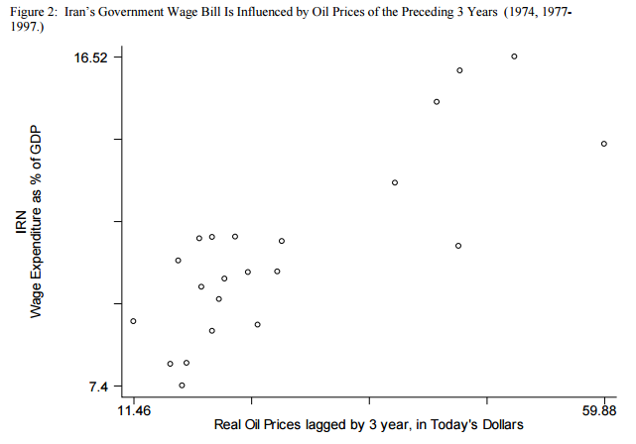
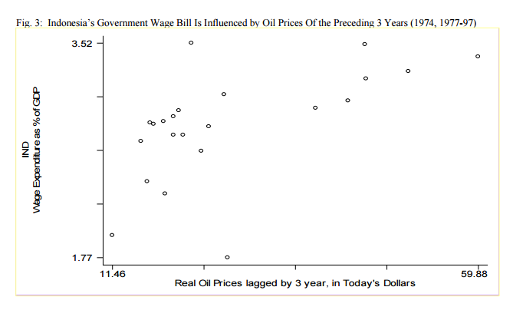
IV. The Dutch Disease and Procyclicality
d. The procyclicality of fiscal policy in developing countries
Two large budget items that account for much of the increased spending from oil booms are investment projects and the government wage bill.

Slide 32
V. Institutions and Policies to Address the Natural Resource Curse
a. Institutions That Were Supposed to Stabilize But Have Not Worked
Marketing boards
Taxation of commodity production
Producer subsidies
Other government stockpiles
Price controls for consumers
OPEC and other International cartels

Slide 33
V. Institutions and Policies to Address the Natural Resource Curse
b. Devices to share risks
Price setting in contracts with foreign companies : A price is set by contract. Later the world price goes up, and then the overnment wants to renege. The risk that the locals will renege makes foreign companies reluctant to do business. It limits the amount of capital available to the country, and probably raises the price of that capital.
Hedging in commodity futures markets : if it is a government ministry doing the hedging, it will be excoriated for having sold out the national patrimony when the world price rises.
Denomination of debt in terms of commodity prices : The result for many countries was an abrupt deterioration of their debt service ratios and a balance of payments crisis. This would not have happened if their debts had been indexed to their commodity prices – oil for such borrowers as Ecuador, Indonesia, Iran, Mexico, Nigeria, and Russia.

Slide 34
V. Institutions and Policies to Address the Natural Resource Curse
c. Monetary policy
Fixed vs. floating exchange rates:
A balancing of the two leads many middle-size middle-income countries to an intermediate exchange rate regime such as managed floating or a target zone. The mid-point of the zone can be defined as a basket of major currencies, rather than a simple bilateral parity against the dollar or euro, if neither the United States nor euroland is the dominant trading partner currency.
Alternative nominal anchors:
Many have, in recent years, considered Inflation Targeting to be the preferred approach alternative to fixed exchange rates, which may be appropriate for very small very open countries. The author proposed a commodity producers a regime called Peg the Export Price (PEP). The idea is that monetary policy be guided by the rule to keep the local-currency price of the export commodity stable from day to day.

Slide 35
V. Institutions and Policies to Address the Natural Resource Curse
d. Institutions to make national saving procyclical
Rules for the budget deficit: The example of Chile
The global recession had hit. Copper prices had fallen abruptly. But the government had increased spending sharply, using the assets that it had acquired during the copper boom, and thereby moderating the downturn. A truly countercyclical fiscal policy was achived.
Under the Chilean rules, the government can run a deficit larger than the target to the extent that:
(1) output falls short of potential, in a recession, or
(2) the price of copper is below its medium-term (10-year) equilibrium

Slide 36
V. Institutions and Policies to Address the Natural Resource Curse
d. Institutions to make national saving procyclical
Commodity funds or Sovereign Wealth Funds
Many natural resource producers have commodity funds, to invest savings for
future welfare, often in global portfolios.
Two standard recommendations are that the funds be transparently and
professionally run, and that they be given clear instructions that politics should not interfere with their objective of maximizing the financial wellbeing of the country.
For most countries it would be more appropriate to have rules dictating the cap on spending out of the fund.

Slide 37
V. Institutions and Policies to Address the Natural Resource Curse
d. Institutions to make national saving procyclical
3. Reserve accumulation by central banks
However, some have regarded this as a sub-optimal mechanism: if the goal is smoothing spending over time, as opposed to stabilization of the exchange rate, holding the assets in the form of foreign exchange reserves has disadvantages. First, the reserves do not earn a high return.
Second, increases in reserves can lead to rapid monetary expansion (if not sterilized) and thereby to inflation. Thus a central bank that already has enough reserves, judged by precautionary and monetary criteria, should consider selling some of the foreign exchange to the country’s Natural Resource Fund.

Slide 38
V. Institutions and Policies to Address the Natural Resource Curse
d. Institutions to make national saving procyclical
Reducing net private capital inflows during booms:
Government deliberately to pay down debt, especially short-term debt.
Remove any remaining controls on the ability of domestic citizens to invest abroad.
Place controls on capital inflows, especially short-term inflows
Lump sum distribution
Eg: The Alaska Permanent Fund saves earnings from the state’s oil sector. Alaska state law says that the Fund must distribute half of the investment earnings on an equal per capita basis.

Slide 39
V. Institutions and Policies to Address the Natural Resource Curse
e. Efforts to impose external checks

Slide 40
Thank you

